Slide 2
Probability Distributions

Slide 3
Random Variable
Random Variable
A variable is random if it takes on different values as result of the outcomes of a random experiment or is an experiment with random outcome.
Random variable is a variable related to a random event.
A random variable is discrete if it has a finite or countable number of possible outcomes that can be listed.
A random variable is Continuous if it has an uncountable number or possible outcomes within a given interval.

Slide 4
Types of Random Variable
Discrete Random variable
If a random variable is allowed to take only limited number of values, which can be listed, it is a discrete random variable.
A discrete random variable can assume only finite number of numerical values.
Eg: Number of students in statistics class.
Continuous Random Variable
If the RV is allowed to assume any value within a given range/interval, then it is a continuous random variable
A continuous random variable can assume infinite number of numerical values. These experimental outcomes are based on interval or ratio scale.
Eg: Waiting time for customer in ATM queue.

Slide 5
Random Variable Example
Random Variable Example
Breast cancer screening clinic, there is no way of know exactly how many women will be screened on any one day.
Tomorrow's number of patients is a random variable , and the values of the random variable are numerical assignments to each possible outcome of the random experiment.
As per the past records, if the daily number of patients ranges between 100 to 115, then the random variable is a discrete random variable.
Average waiting time taken for a patient to get screened is a continuous random variable.

Slide 6
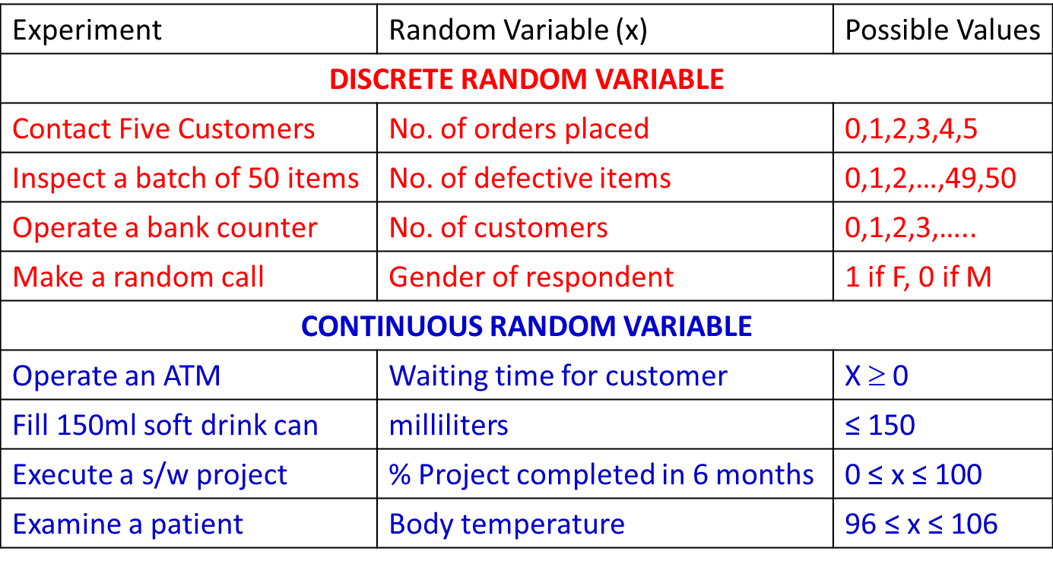
Random Variable – More Examples

Slide 7
Probability distributions
A probability distribution of a random variable X is a description of the probabilities associated with the possible values of X.

Slide 8
Probability distributions – Coin Toss Example
X = Number of heads after 3 flips of a fair coin

Slide 9
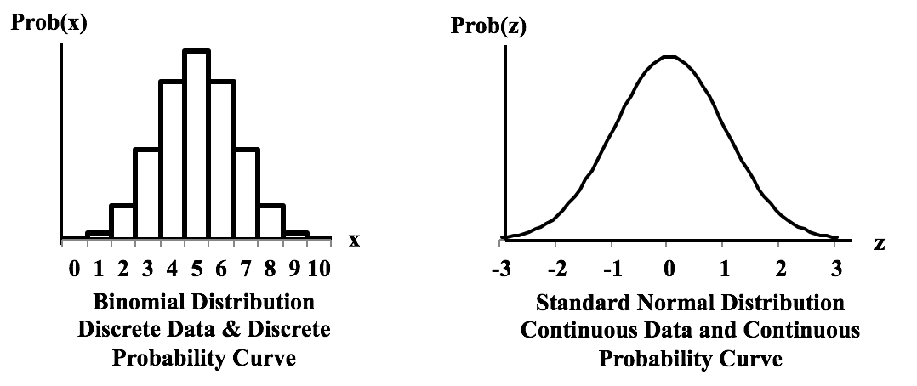
Types of Probability Distributions
Discrete Probability Distribution
Continuous Probability Distributions

Slide 10
Discrete Probability Distribution

Slide 11
Discrete Probability Distribution
A probability distribution for a random variable describes how probabilities are distributed for different values assumed by the random variable.
It is a mutually exclusive list of all the possible numerical outcomes along with the probability of occurrence of each outcome.
Mean or Expected value of a discrete random variable
E(x) = μ = Σ xf(x)
Variance of a discrete random variable
Var(x) = σ² = Σ (x- μ)²f(x)

Slide 12
Probability Mass Function (PMF)
The probability distribution for a discrete random variable is described with a probability mass function

Slide 13
Rules for Discrete Probability Distribution or PMF – Example 1
[x ,f(x)] is said to constitute Probability Distribution if :
x is a random variable
f(x) > = 0
Σf(x) = 1
Data which satisfies this rules is a valid Probability distribution.

Slide 14
Calculate Expected value and Variance
Mean or Expected value of a discrete random variable
E(x) = μ = Σ xf(x)
Variance of a discrete random variable
Var(x) = σ² = Σ (x- μ)²f(x)

Slide 15
Discrete Probability Distribution – Example 2
Distribution of the number of interruptions per day in a large computer network.

Slide 16
Discrete Probability Distribution – Expectation and Variance Calculation
Distribution of the number of interruptions per day in a large computer network
Mean or Expected value of a discrete random variable
E(x) = μ = Σ xf(x)
Variance of a discrete random variable
Var(x) = σ² = Σ (x- μ)²f(x)

Slide 17
Cumulative Distribution Function – CDF :
The cumulative distribution function (CDF) of a random variable is another method to describe the distribution of random variables.
The advantage of the CDF is that it can be defined for any kind of random variable (discrete, continuous)

Slide 18
Cumulative distribution function (CDF)
x
P(x≤A)
1
P(x≤1)=1/6
P(x)
1.0
2
P(x≤2)=2/6
5/6
2/3
3
P(x≤3)=3/6
1/2
1/3
4
P(x≤4)=4/6
1/6
1
2
3
4
5
6
x
5
P(x≤5)=5/6
6
P(x≤6)=6/6

Slide 19
Discrete Probability Distribution
Binomial
Bernoulli
Poisson

Slide 20
Binomial Distribution

Slide 21
Binomial Distribution
Is a discrete probability distribution.
It is a multistep experiment.
Properties (or assumptions) of binomial experiment:
The experiment consists of a sequence on n trials.
Only two outcomes are possible in each trial. We refer to one of them as “success” and the other as “failure”.
The probability of success is denoted by p, does not change from trial to trial.
The probability of failure is given by (1-p) as a consequence of above.
The trials are independent.

Slide 22
Binomial Distribution – Business Examples
How many of the customers visiting a supermarket make a purchase?
How many calls of an insurance agent will result in subscription?
How many purchases will be made using credit card?

Slide 23
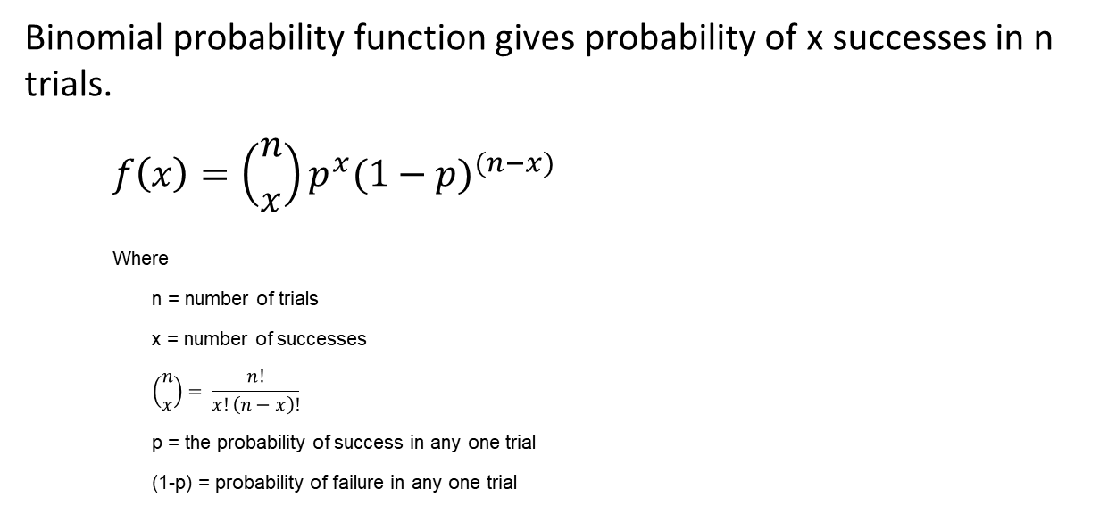
Binomial Probability Function
Binomial probability function gives probability of x successes in n trials.
$$f\left(x\right)=\left({n \atop x}\right)p^{x}{(1−p)}^{(n−x)}$$
Where
n = number of trials
x = number of successes
$$\left({n \atop x}\right)= \frac{n!}{x!\left(n−x\right)!}$$
p = the probability of success in any one trial
(1-p) = probability of failure in any one trial

Slide 24
Bernoulli Process
Each trial of a binomial experiment is a Bernoulli process.
A Benorulli process is a single trial resulting in either a success S = 1 or a Failure F = 0.
Probability of success s is p and that failure F is (1-p)
The mean of Bernoulli experiment is 1*p + 0*(1-p) = p ; 1 * success + 0 * failure
The variance of Bernoulli trial is
Var(x) = p (1-p)² + (1-p)(0-p)² = p –p³ –p² + p³ = p(1-p)
Please note
μ _{x±y} = μ_{x}± μ_{y}
σ²_{x±y} = σ²_{x} + σ²_{y}

Slide 25
Mean and Variance of Binomial Distribution
A binomial experiment is a series of n Bernoulli trials. Therefore
μx = p + p + … n times = np
Let (1-p) = q then
For a Bernoulli trial
Var(b) = pq
For n trials
Var(x) = pq + pq + … n times = npq = np(1-p)

Slide 26
Binomial - Martin Cloth store problem
On the basis of past experience Martin Cloth Store manager estimates that the probability of purchase by any customer is 0.3 and purchase decision of one customer does not influence the other. What is the probability of 2 of the next 3 customers will make a purchase?

Slide 27
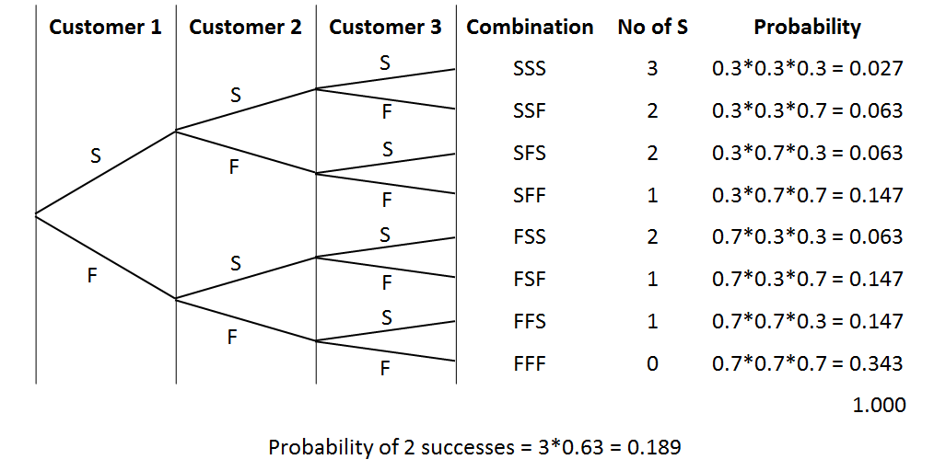
Binomial - Martin Cloth Store problem
3 *P^2 * (1-p)

Slide 28
Poisson Distribution

Slide 29
Poisson Distribution
A probability Distribution that is used to estimating number of occurrences over a specified interval of time or space.
Properties of Poisson Probability Function
The probability of occurrence is same in two intervals of same length.
The probability of occurrence or non-occurrence is independent of occurrence or non-occurrence in any other interval.

Slide 30
Poisson Distribution – Business Examples
No. of persons arriving at a service station or ATM.
No. of calls coming to a call center in a given interval.
No. of defects in a length of cloth from a loom.
No. of accidents in a given length of highway.

Slide 31
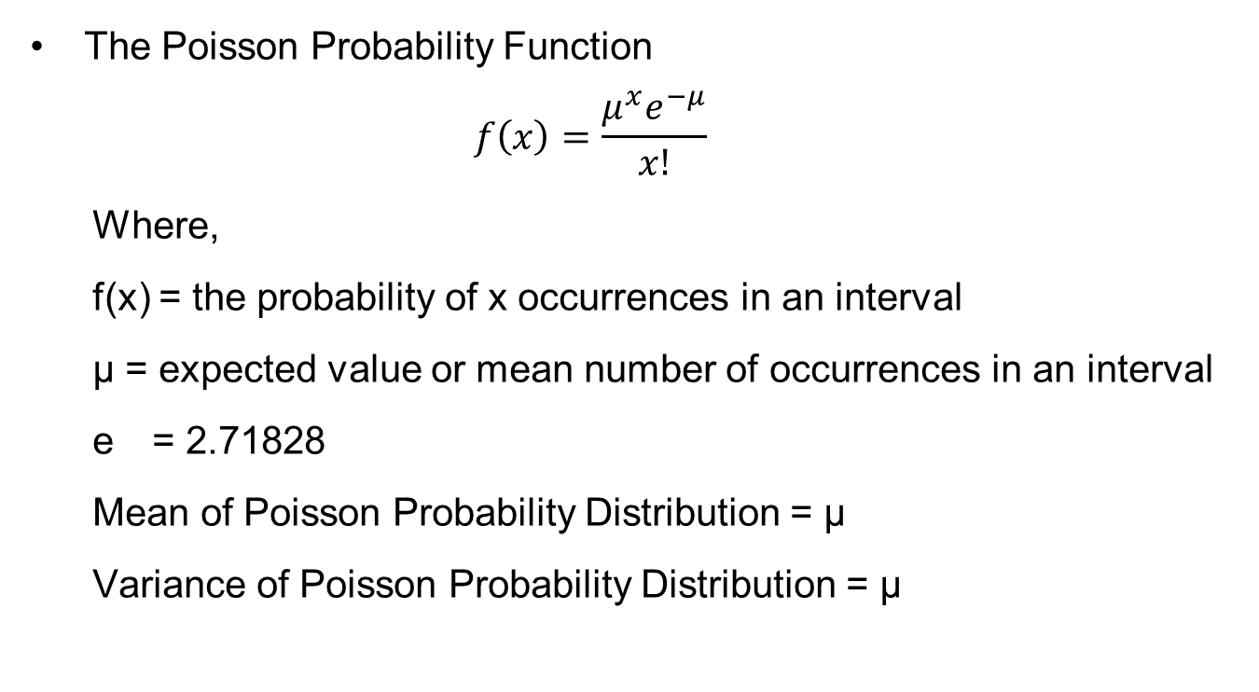
Poisson Probability Function
The Poisson Probability Function
$$f\left(x\right)=\frac{μ^{x}e^{−μ}}{x!}$$
Where,
f(x) = the probability of x occurrences in an interval
μ = expected value or mean number of occurrences in an interval
e = 2.71828
Mean of Poisson Probability Distribution = μ
Variance of Poisson Probability Distribution = μ

Slide 32
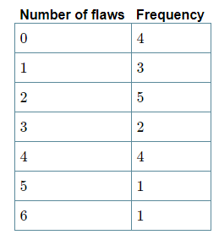
Poisson Distribution - Example
Twenty sheets of aluminum alloy were examined for surface flaws. The frequency of the number of sheets with a given number of flaws per sheet was as follows:
What is the probability of finding a sheet chosen
at random which contains 3 or more surface flaws?

Slide 33
Poisson Distribution - Example
Example: A Life Insurance agent sells on the average 3 life insurance policies per week.
Use the Poisson law to calculate the probability that in a given week, he will sell
a. Some policies
b. 2 or more but less than 5 policies?
Solution:
a. P(X>=0)
> ppois(0, lambda=3,lower=FALSE) # we need to find the upper tail of the probability mf
[1] 0.9502129
b. P(2<=X<=5)
ppois(1, lambda=3,lower=FALSE) # Probability of more than 1 policy
ppois(4, lambda=3,lower=FALSE) # Probability of more than 4 policies
> ppois(1, lambda=3,lower=FALSE) - ppois(4, lambda=3,lower=FALSE)
[1] 0.616115

Slide 34
Continuous Probability Distribution

Slide 35
Continuous Probability Function
Assume that to come to this class you travel for 45mins to 1 hour.
If your travel time is a random variable it may take value between 45 and 60 including decimal values.
So the travel time is a continuous random variable.
All the random variables measured on interval and ratio scale are continuous random variables.
For a continuous random variable
The probability at any point is 0. (Area under curve only makes sense)
Only probabilities exist for intervals. We do not talk about probability of RV assuming particular value. We talk about probability for a given interval.
The cumulative probability is equal to 1 i.e. sample space.
The probability density can never be negative.
The probability density can exceed 1.
Area is a measure of probability.

Slide 36
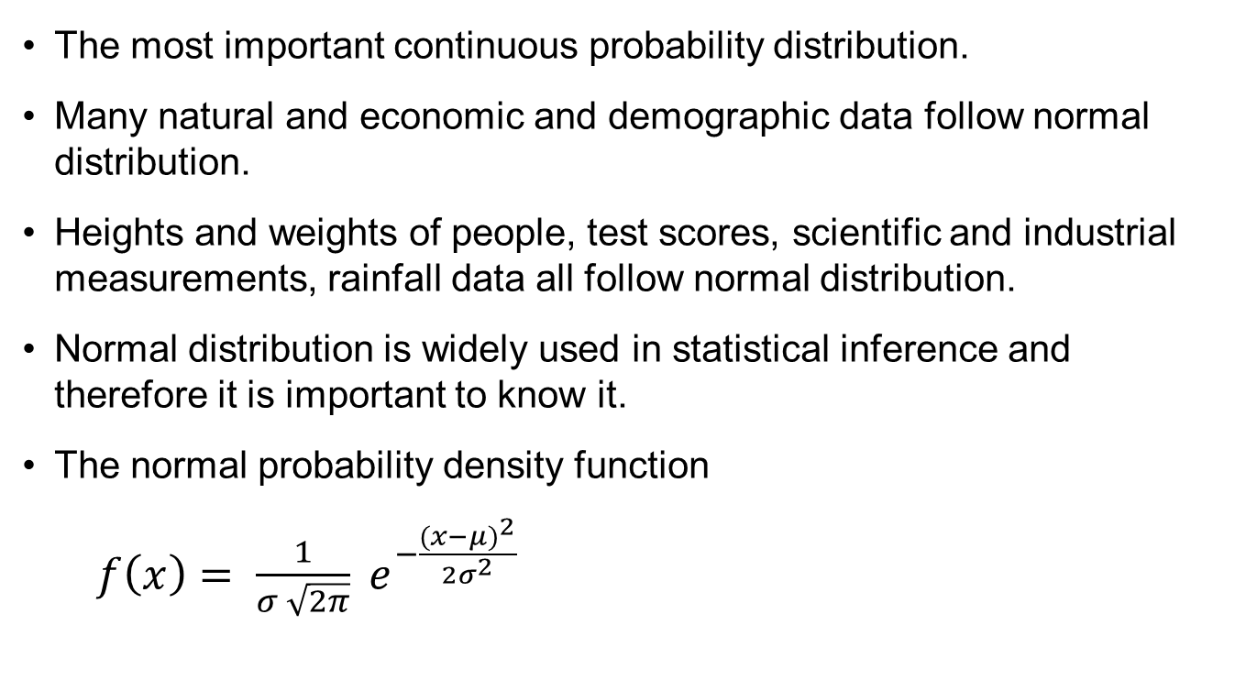
Normal Distribution
The most important continuous probability distribution.
Many natural and economic and demographic data follow normal distribution.
Heights and weights of people, test scores, scientific and industrial measurements, rainfall data all follow normal distribution.
Normal distribution is widely used in statistical inference and therefore it is important to know it.
The normal probability density function
$f\left(x\right)= \frac{1}{σ \sqrt{2π}} e^{−\frac{{(x−μ)}^{2}}{2σ^{2}}}$

Slide 37
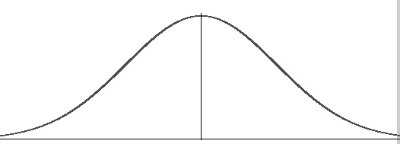
Normal Probability Distribution
The entire family of normal probability distributions is differentiated by its mean and standard deviation.
The highest point of the distribution is the mean which is also the median and mode of the distribution.
The mean can be any numeral +ve, 0 or -ve.
Normal distribution is symmetric on y axis, bisected by mean.
The tails of the curve extend to infinity.
Standard deviation σ
x
mean

Slide 38
Normal Probability Distribution
x
-10
-0
10
Same standard deviation different means
Standard deviation σ = 5
Standard deviation σ = 10
0
x
Same mean different standard deviations

Slide 39
The Normal Curve
68%
95.5%
99.75%
-3σ
-2σ
-1σ
μ
1σ
2σ
3σ

Slide 40
Normal distribution table
z | 0.00 | 0.01 | 0.02 | 0.03 | 0.04 | 0.05 | 0.06 | 0.07 | 0.08 | 0.09
0.0 | .0000 | .0040 | .0080 | .0120 | .0160 | .0199 | .0239 | .0279 | .0319 | .0359
0.1 | .0398 | .0438 | .0478 | .0517 | .0557 | .0596 | .0636 | .0675 | .0714 | .0753
0.2 | .0793 | .0832 | .0871 | .0910 | .0948 | .0987 | .1026 | .1064 | .1103 | .1141
0.3 | .1179 | .1217 | .1255 | .1293 | .1331 | .1368 | .1406 | .1443 | .1480 | .1517
0.4 | .1554 | .1591 | .1628 | .1664 | .1700 | .1736 | .1772 | .1808 | .1844 | .1879
0.5 | .1915 | .1950 | .1985 | .2019 | .2054 | .2088 | .2123 | .2157 | .2190 | .2224
0.6 | .2257 | .2291 | .2324 | .2357 | .2389 | .2422 | .2454 | .2486 | .2517 | .2549
0.7 | .2580 | .2611 | .2642 | .2673 | .2704 | .2734 | .2764 | .2794 | .2823 | .2852
0.8 | .2881 | .2910 | .2939 | .2967 | .2995 | .3023 | .3051 | .3078 | .3106 | .3133
0.9 | .3159 | .3186 | .3212 | .3238 | .3264 | .3289 | .3315 | .3340 | .3365 | .3389
1.0 | .3413 | .3438 | .3461 | .3485 | .3508 | .3531 | .3554 | .3577 | .3599 | .3621
1.1 | .3643 | .3665 | .3686 | .3708 | .3729 | .3749 | .3770 | .3790 | .3810 | .3830
1.2 | .3849 | .3869 | .3888 | .3907 | .3925 | .3944 | .3962 | .3980 | .3997 | .4015
1.3 | .4032 | .4049 | .4066 | .4082 | .4099 | .4115 | .4131 | .4147 | .4162 | .4177
1.4 | .4192 | .4207 | .4222 | .4236 | .4251 | .4265 | .4279 | .4292 | .4306 | .4319
1.5 | .4332 | .4345 | .4357 | .4370 | .4382 | .4394 | .4406 | .4418 | .4429 | .4441
1.6 | .4452 | .4463 | .4474 | .4484 | .4495 | .4505 | .4515 | .4525 | .4535 | .4545
1.7 | .4554 | .4564 | .4573 | .4582 | .4591 | .4599 | .4608 | .4616 | .4625 | .4633
1.8 | .4641 | .4649 | .4656 | .4664 | .4671 | .4678 | .4686 | .4693 | .4699 | .4706
1.9 | .4713 | .4719 | .4726 | .4732 | .4738 | .4744 | .4750 | .4756 | .4761 | .4767
2.0 | .4772 | .4778 | .4783 | .4788 | .4793 | .4798 | .4803 | .4808 | .4812 | .4817
2.1 | .4821 | .4826 | .4830 | .4834 | .4838 | .4842 | .4846 | .4850 | .4854 | .4857
2.2 | .4861 | .4864 | .4868 | .4871 | .4875 | .4878 | .4881 | .4884 | .4887 | .4890
2.3 | .4893 | .4896 | .4898 | .4901 | .4904 | .4906 | .4909 | .4911 | .4913 | .4916
2.4 | .4918 | .4920 | .4922 | .4925 | .4927 | .4929 | .4931 | .4932 | .4934 | .4936
2.5 | .4938 | .4940 | .4941 | .4943 | .4945 | .4946 | .4948 | .4949 | .4951 | .4952
2.6 | .4953 | .4955 | .4956 | .4957 | .4959 | .4960 | .4961 | .4962 | .4963 | .4964
2.7 | .4965 | .4966 | .4967 | .4968 | .4969 | .4970 | .4971 | .4972 | .4973 | .4974
2.8 | .4974 | .4975 | .4976 | .4977 | .4977 | .4978 | .4979 | .4979 | .4980 | .4981
2.9 | .4981 | .4982 | .4982 | .4983 | .4984 | .4984 | .4985 | .4985 | .4986 | .4986
3.0 | .4987 | .4987 | .4987 | .4988 | .4988 | .4989 | .4989 | .4989 | .4990 | .4990

Slide 41
Probability Calculations using Normal Curve
Using standard normal distribution we can find out probability that z assumes certain value.
z | Area = Probability
< 1 | 0.3413 + 0.5 = 0.8413
> 2 | 0.5000 – 0.4772 = 0.0228
1 < z < 2 | 0.4772 – 0.3413 = 0.1359
< -2 | = > +2 = 0.5000 – 0.4772 = 0.0228
-1 < z < -0.5 | = 0.5 < z < 1 = 0.3413 – 0.1915 = 0.1498
-1 < z < 1.5 | = z < 1 + z < 1.5 = 0.3413 + 0.4332 = 0.7745

Slide 42
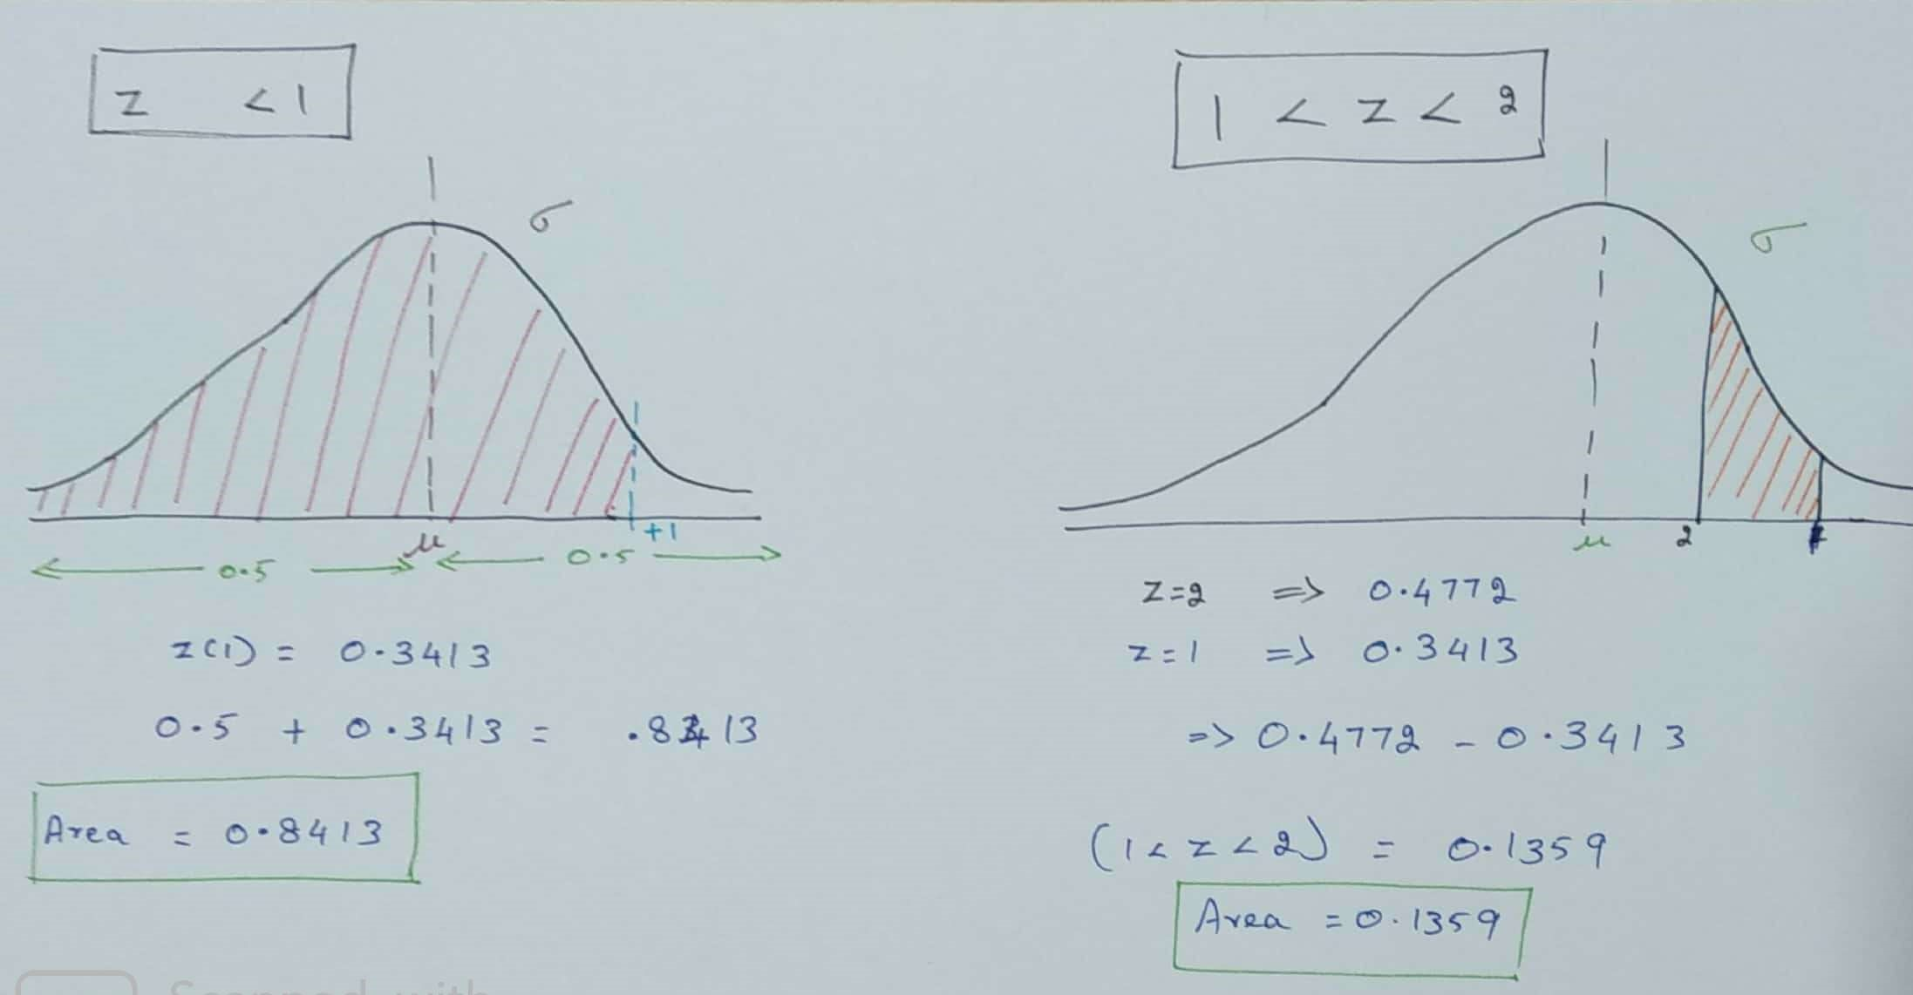
Probability Calculations using Normal Curve
Solution

Slide 43
Sampling

Slide 44
Sampling
A population is the set of all the elements of interest in a study.
A sample is a subset of population.
When selected properly a sample is a representative of the population.
i.e. the characteristics of sample provide an estimate (approximation) of population characteristics.
These characteristics namely mean, standard deviation, variance, median (and a host of others) in the context of population are called parameters and in the context of sample are called statistics.

Slide 45
Statistics – The Big Picture
Sample
Population
Data
1. Produce Data
2. Exploratory Data Analysis
(EDA)
3. Inference
Probability
Inference
Estimation
Hypothesis Testing

Slide 46
Sampling Terminology
Term | Description
Population | Set of all items of interest. Size = N
Sample | A subset chosen from population for study. Size = n
Sampling Unit | An indivisible unit of population liable to be included in the sample set.
Sampling Frame | An object that represents population and facilitates selection of sample set.
Sampling | Selection of n units from N units of population with or without replacement.
Sampling fraction (f) | The ratio f = n / N.

Slide 47
Simple Random Sampling
Every sample of size n has the same probability of being selected.
If there are N units in population, then all samples of size n have the same probability of 1/(^{N}C_{n}) of getting selected.
Procedure for SRS:
Prepare a unique list of N units of population – sampling frame.
Select n units from the list at random.
Example:
A bank wants to study customer perception of quality of its services to savings account holders. It is decided to go for a sample study. Say there are 1000 account holders and we want to select 50 a/c holders for the study.

Slide 48
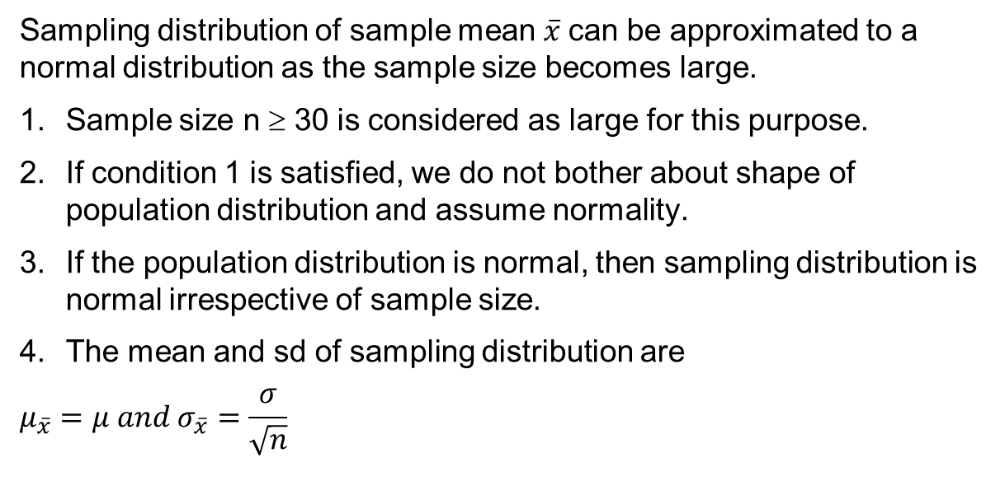
Sampling Distribution
Sampling distribution of sample mean $\overline{x}$can be approximated to a normal distribution as the sample size becomes large.
Sample size n ≥ 30 is considered as large for this purpose.
If condition 1 is satisfied, we do not bother about shape of population distribution and assume normality.
If the population distribution is normal, then sampling distribution is normal irrespective of sample size.
The mean and sd of sampling distribution are
$$μ_{\overline{x}}=μ and σ_{\overline{x}}=\frac{σ}{\sqrt{n}}$$
μ

Slide 49
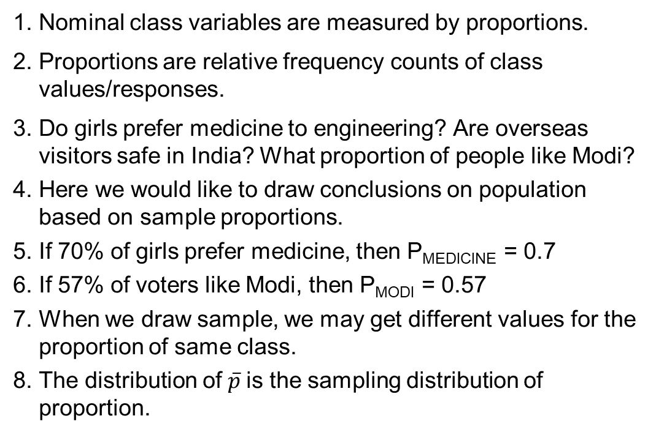
Sampling Distribution for Sample Proportion
Nominal class variables are measured by proportions.
Proportions are relative frequency counts of class values/responses.
Do girls prefer medicine to engineering? Are overseas visitors safe in India? What proportion of people like Modi?
Here we would like to draw conclusions on population based on sample proportions.
If 70% of girls prefer medicine, then P_{MEDICINE} = 0.7
If 57% of voters like Modi, then P_{MODI} = 0.57
When we draw sample, we may get different values for the proportion of same class.
The distribution of $\overline{p}$is the sampling distribution of proportion.

Slide 50
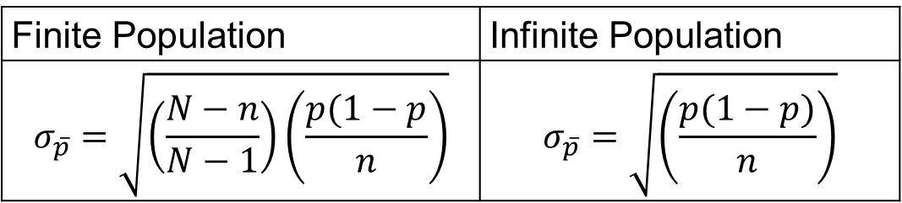
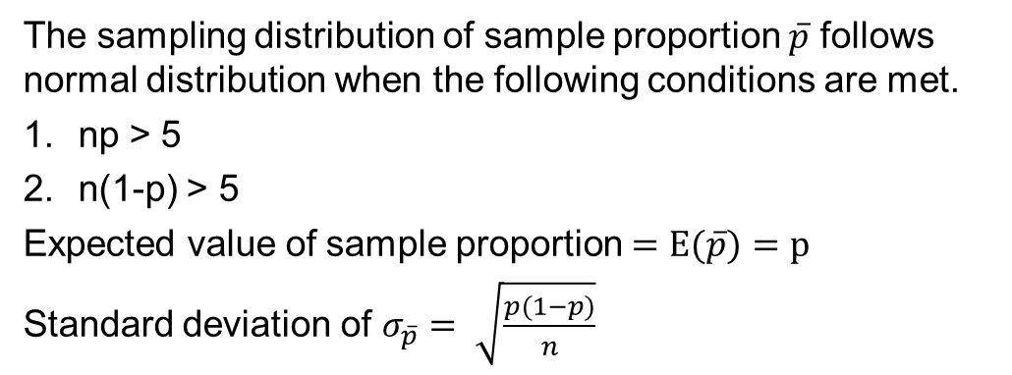
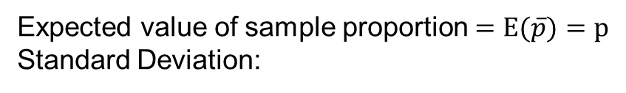
Statistics for Proportions
Expected value of sample proportion $=E(\overline{p})=p$
Standard Deviation:
Finite Population | Infinite Population
$$σ_{\overline{p}}=\sqrt{\left(\frac{N−n}{N−1}\right)\left(\frac{p(1−p}{n}\right)}$$ | $$σ_{\overline{p}}=\sqrt{\left(\frac{p(1−p)}{n}\right)}$$
The sampling distribution of sample proportion $\overline{p}$ follows normal distribution when the following conditions are met.
np > 5
n(1-p) > 5
Expected value of sample proportion $=E(\overline{p})=p$
Standard deviation of $σ_{\overline{p}}= \sqrt{\frac{p(1−p)}{n}}$

Slide 51
Central Limit Theorem

Slide 52
Central Limit Theorem
If sample random sample of size n is selected for a distribution with mean and standard deviation, then the distribution of the sample mean approach a normal distribution, irrespective of parent distribution of population.
The greater the sample size, better is the approximation ( typically n >= 30)

Slide 53
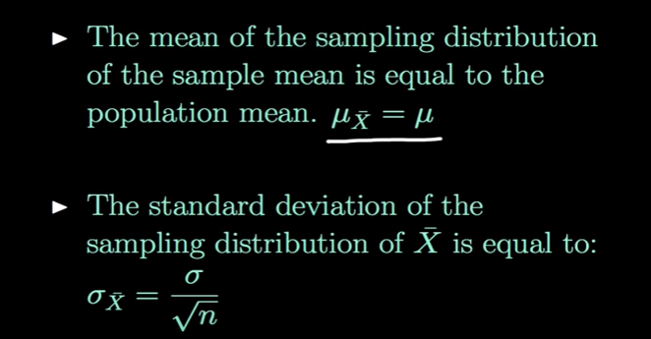
Central Limit Theorem – Key Points

Slide 54
CLT - Mean
Manual calculation, to prove Sample mean is
Equal to population mean
 | Input | Sample | Mean
 | 3 | s1 | 3.5
 | 4 | s2 | 5
 | 6 | s3 | 4
 | 2 | s4 | 3
 | 4 | s5 | 4.5
 | 5 | s6 | 6.5
 | 8
Mean of Population | 4.571 | Mean of Sample Means | 4.417
 | S1 = (3 +4)/2 = 3.5

Slide 55
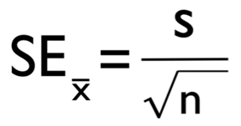
CLT – Standard deviation
Standard error is the standard deviation of the sampling distribution of a statistic. It can be abbreviated as S.E.
The statistical inference involved in the construction of the confidence interval is mainly based on standard error.
S is std deviation, n sample size
 | Dataset 1 | Dataset 2
 | 9 | 10.9
 | 15 | 11.9
 |  | 12.2
 |  | 12.2
 |  | 12.9
 |  | 12.6
 |  | 12.3
 |  | 12.3
 |  | 12.5
 |  | 10.2
Mean | 12 | 11.4
Std dev | 4.242641 | 0.825967
Std error = std dev / sqrt(n) | 3 | 0.261194

Slide 56
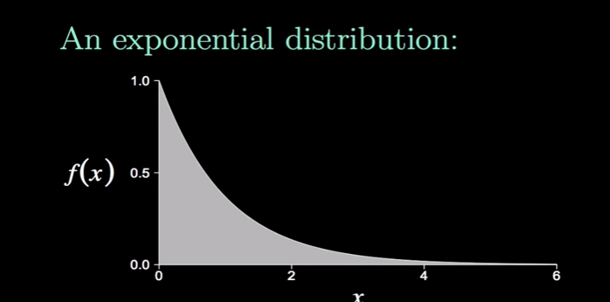
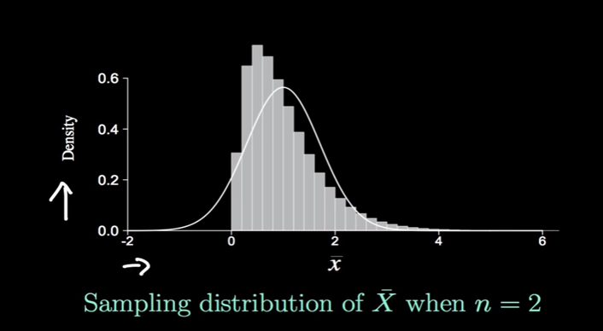
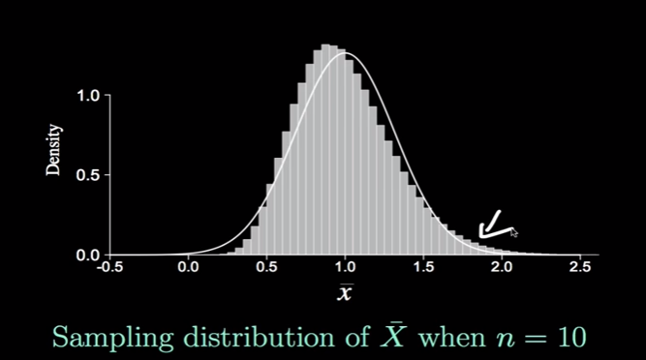
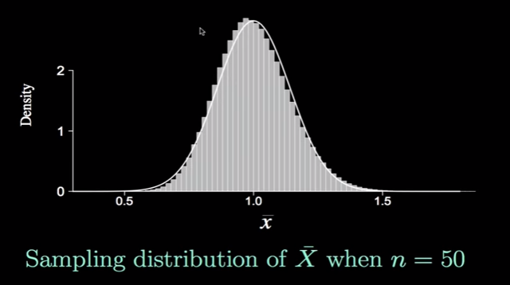
Central Limit Theorem – Graph based on samples
Sample mean to be appr. Normal distributed, sample size should be >= 30

Slide 57
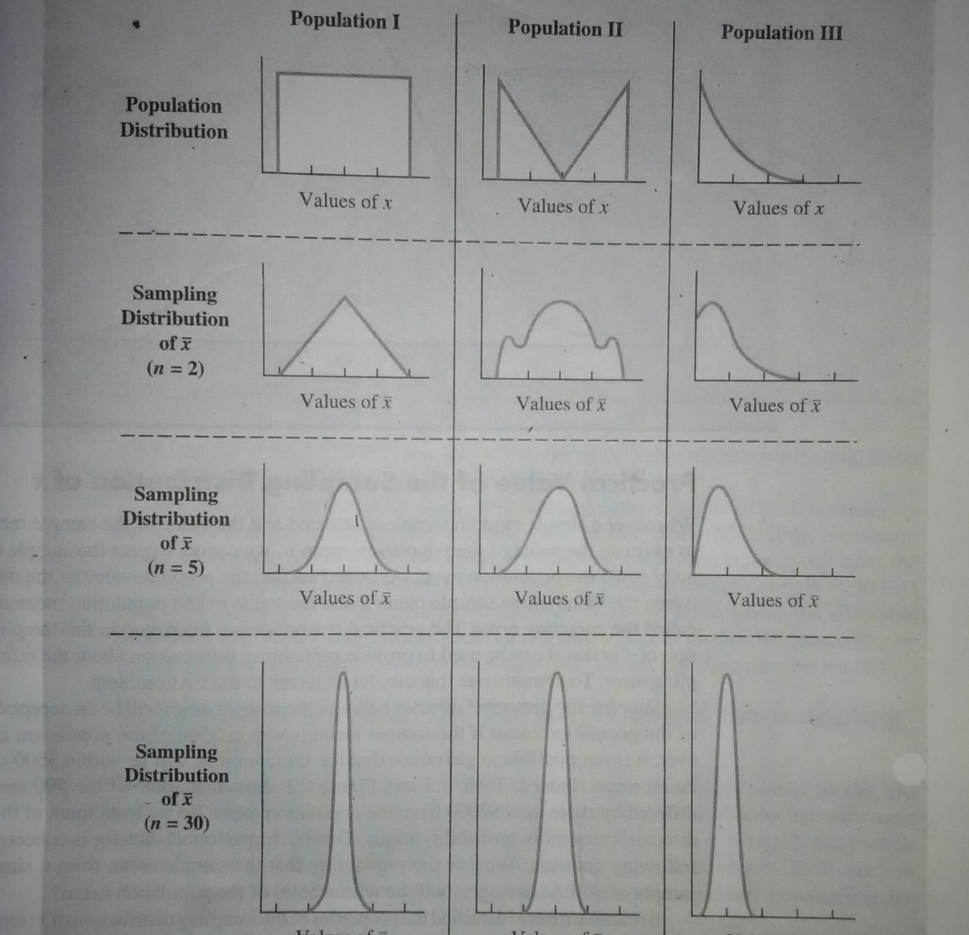
Central limit Theorem
When Central Limit Theorem is applicable, normality of population shape is not required.

Slide 58
Estimation

Slide 59
Estimation
Estimation is part of life.
When you are ready to cross a street, you estimate the speed of any car that is approaching.
Distance between you and that car, and your own speed is roughly calculated.
Having made these quick estimate you decide whether to wait, walk or run.
You know that the speed you estimated is not exact but allow for a margin of error to be safe while crossing.

Slide 60
Estimator
Any sample statistics that is used to estimate a population parameter is called an estimator.

Slide 61
Point Estimation
Sample
Compute Statistic. The statistic is the point estimator of Population parameter
Population

Slide 62
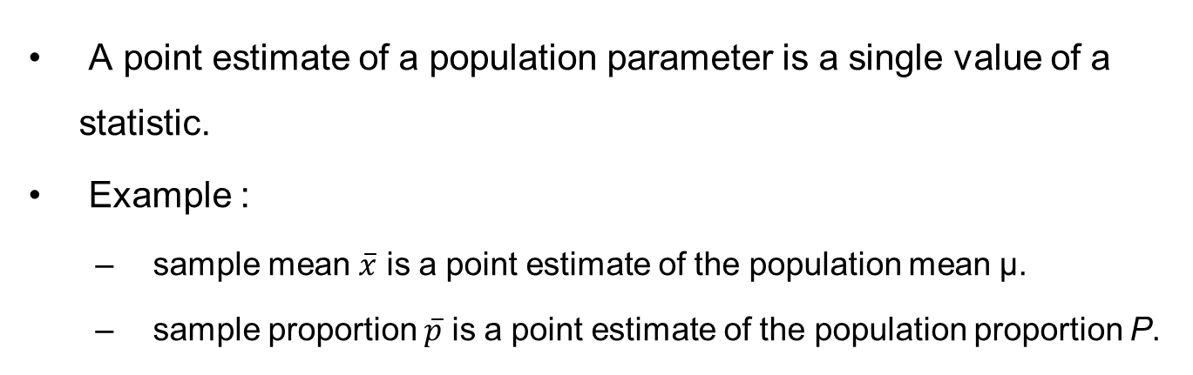
Point Estimation
A point estimate of a population parameter is a single value of a statistic.
Example :
sample mean $\overline{x}$ is a point estimate of the population mean μ.
sample proportion $\overline{p}$ is a point estimate of the population proportion P.

Slide 63
Point Estimation
Parameters are numbers that summarize data for an entire population.
This means the parameter tells us something about the whole population.
It is any numerical quantity that characterizes a given population
Statistics are numbers that summarize data from a sample, i.e. some subset of the entire population.

Slide 64
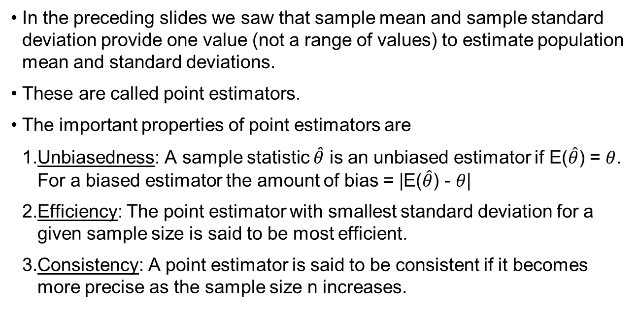
Criteria of a Good Estimator
In the preceding slides we saw that sample mean and sample standard deviation provide one value (not a range of values) to estimate population mean and standard deviations.
These are called point estimators.
The important properties of point estimators are
Unbiasedness: A sample statistic $\hat{θ}$ is an unbiased estimator if E($\hat{θ}$) = $θ$. For a biased estimator the amount of bias = |E($\hat{θ}$) - $θ$|
Efficiency: The point estimator with smallest standard deviation for a given sample size is said to be most efficient.
Consistency: A point estimator is said to be consistent if it becomes more precise as the sample size n increases.

Slide 65
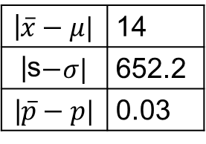
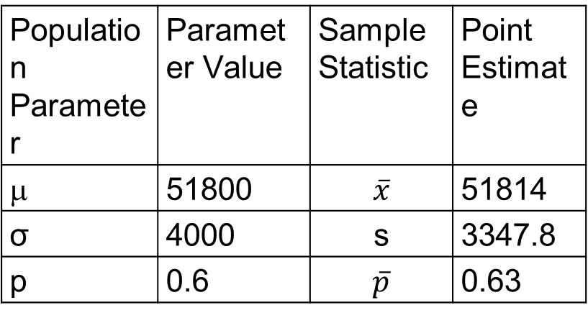
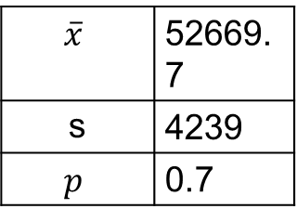
Point Estimation Table
Population Parameter | Parameter Value | Sample Statistic | Point Estimate
μ | 51800 | $$\overline{x}$$ | 51814
σ | 4000 | s | 3347.8
p | 0.6 | $$\overline{p}$$ | 0.63
Sampling Error:
Sample 2:
|$\overline{x}−μ|$ | 14
|s$−σ|$ | 652.2
|$\overline{p}−p|$ | 0.03
$$\overline{x}$$ | 52669.7
s | 4239
$$p$$ | 0.7

Slide 66
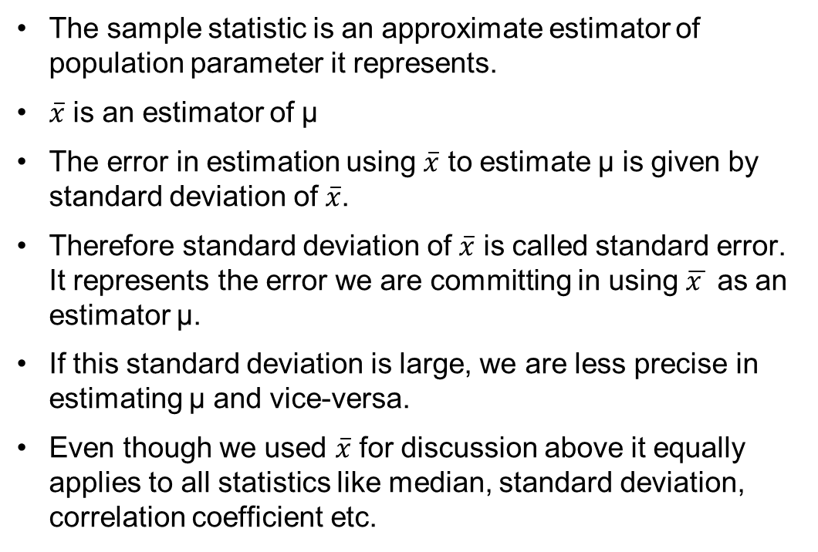
Standard Error
The sample statistic is an approximate estimator of population parameter it represents.
$\overline{x}$ is an estimator of μ
The error in estimation using $\overline{x}$ to estimate μ is given by standard deviation of $\overline{x}$.
Therefore standard deviation of $\overline{x}$ is called standard error. It represents the error we are committing in using $\overline{x }$ as an estimator μ.
If this standard deviation is large, we are less precise in estimating μ and vice-versa.
Even though we used $\overline{x}$ for discussion above it equally applies to all statistics like median, standard deviation, correlation coefficient etc.

Slide 67
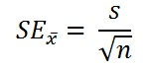
Standard Error
Standard Error is a method of measurement or estimation of standard deviation of sampling distribution associated with an estimation method.
Observations = (10,20,30,40,50) No. Of Obs = 5
Mean (x_{m}) = 30
SD = 15.811
Standard Error = SD/ √(N) Standard Error = 15.811/√(5) Standard Error = 7.071

Slide 68
Interval Estimation
An interval estimate is defined by two numbers.
Interval within which a population parameter is very likely to lie.
Example, a < µ < b is an interval estimate of the population mean μ.
It indicates that the population mean is greater than a but less than b.

Slide 69
Confidence Interval
Statisticians use a confidence interval to express the precision and uncertainty associated with a given sampling method. A confidence interval consists of three parts.
A confidence level.
A statistic (Mean or Proportion)
A margin of error.

Slide 70
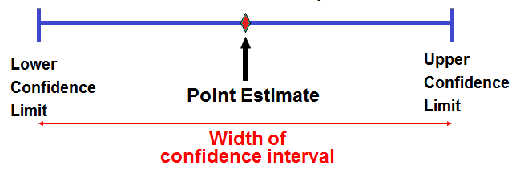
Confidence Interval

Slide 71
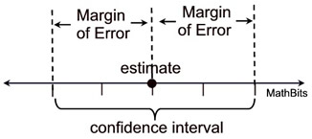
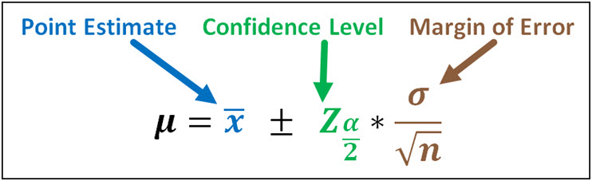
Confidence Level
Confidence levels are used when two sets of data are being compared.
A confidence level is the likelihood of obtaining a particular result by chance rather than due to a truly significant difference in the two sets of data.
A confidence interval addresses this issue because it provides a range of values which is likely to contain the population parameter of interest.
A 95% confidence interval means that there is a 95% chance that the confidence interval contains the population mean.

Slide 72
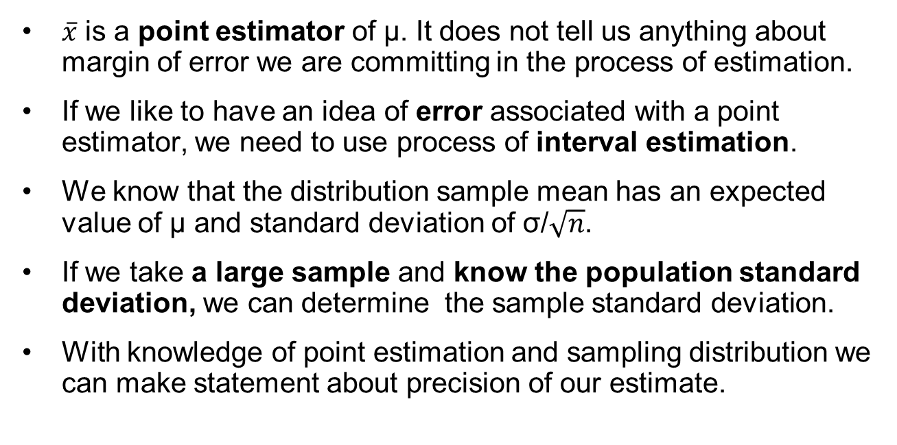
Interval estimation of Population Mean
$\overline{x}$ is a point estimator of μ. It does not tell us anything about margin of error we are committing in the process of estimation.
If we like to have an idea of error associated with a point estimator, we need to use process of interval estimation.
We know that the distribution sample mean has an expected value of μ and standard deviation of σ/$\sqrt{n}$.
If we take a large sample and know the population standard deviation, we can determine the sample standard deviation.
With knowledge of point estimation and sampling distribution we can make statement about precision of our estimate.

Slide 73
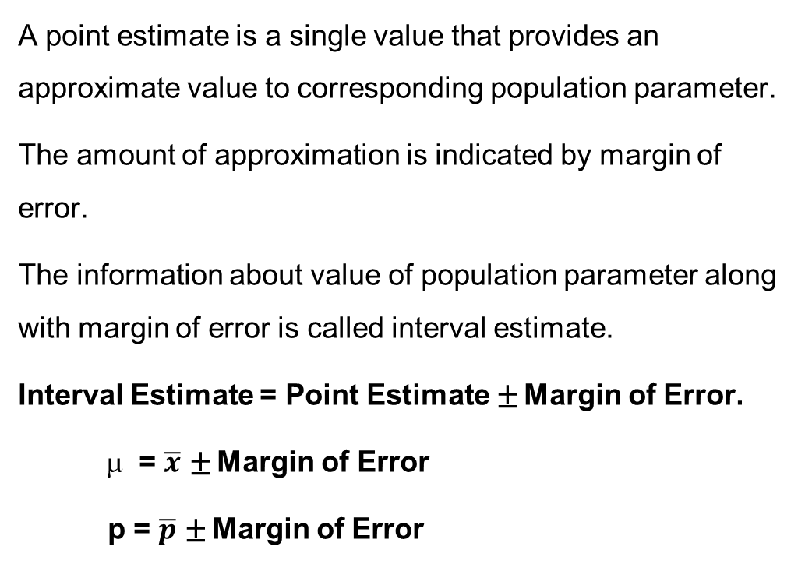
Interval Estimation of Population Mean
A point estimate is a single value that provides an approximate value to corresponding population parameter.
The amount of approximation is indicated by margin of error.
The information about value of population parameter along with margin of error is called interval estimate.
Interval Estimate = Point Estimate ± Margin of Error.
= $\overline{x}$ ± Margin of Error
p = $\overline{p}$ ± Margin of Error

Slide 74
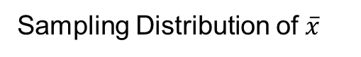
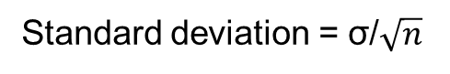
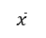
Interval Estimation
Sampling Distribution of $\overline{x}$
Standard deviation = σ/$\sqrt{n}$
μ
$$\overline{x}$$
mean
If the population σ is 20 and sample size is 100 then the standard deviation (standard error) of sampling distribution is 20/sqrt(100) = 2.

Slide 75
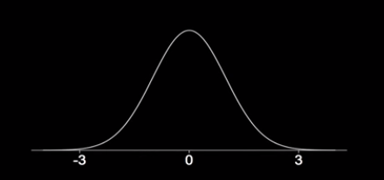
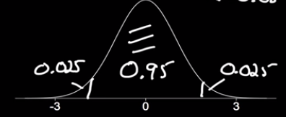
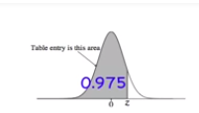
Calculate Confidence Coefficient for a given CI
What is the approximate z value for a 95% confidence Interval ?
(1- α) 100% = 95%
100%-100^{α} % = 95%
-100 α % =-5%
α = 5/100 = .05
α = 0.05
Area to the left of the required z value = 1- 0.025
=0.975
Z α /2 (critical value) = 1.96

Slide 76
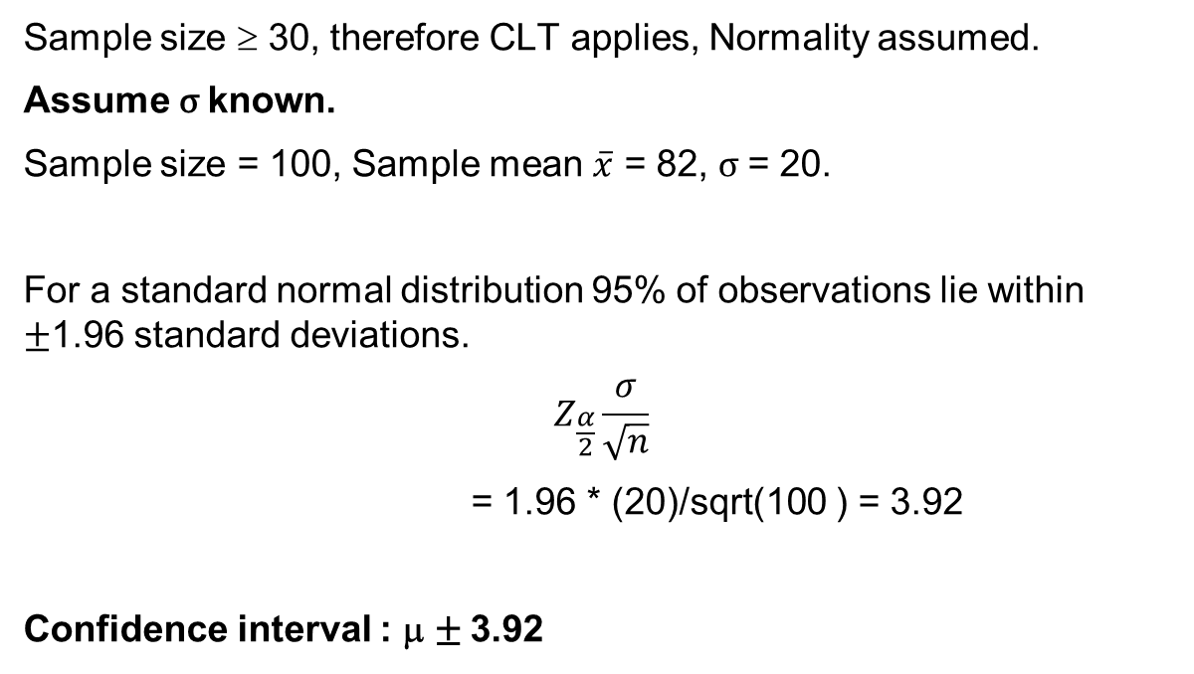
Interval Estimation for Population Mean – Large Sample
Sample size ≥ 30, therefore CLT applies, Normality assumed.
Assume σ known.
Sample size = 100, Sample mean $\overline{x}$ = 82, σ = 20.
For a standard normal distribution 95% of observations lie within ±1.96 standard deviations.
$$Z_{\frac{α}{2}}\frac{σ}{\sqrt{n}}$$
= 1.96 * (20)/sqrt(100 ) = 3.92
Confidence interval : μ ± 3.92

Slide 77
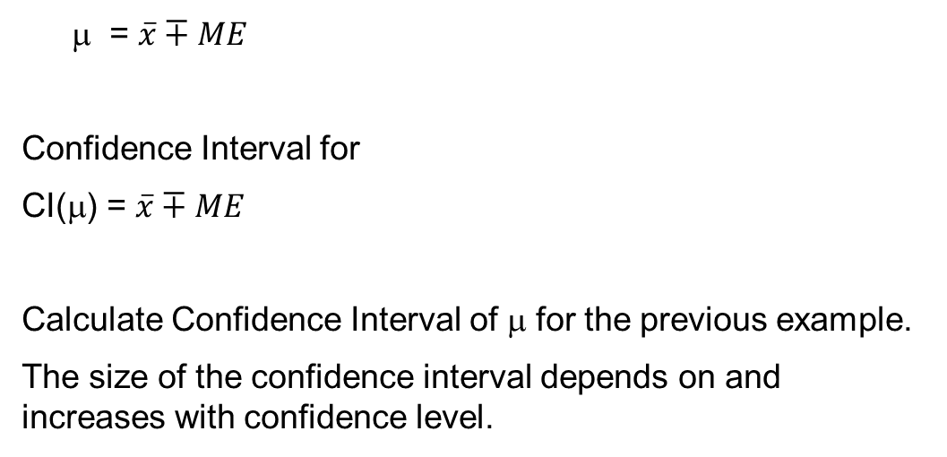
Confidence Interval for μ
= $\overline{x}∓ME$
Confidence Interval for
CI(μ) = $\overline{x}∓ME$
Calculate Confidence Interval of μ for the previous example.
The size of the confidence interval depends on and increases with confidence level.

Slide 78
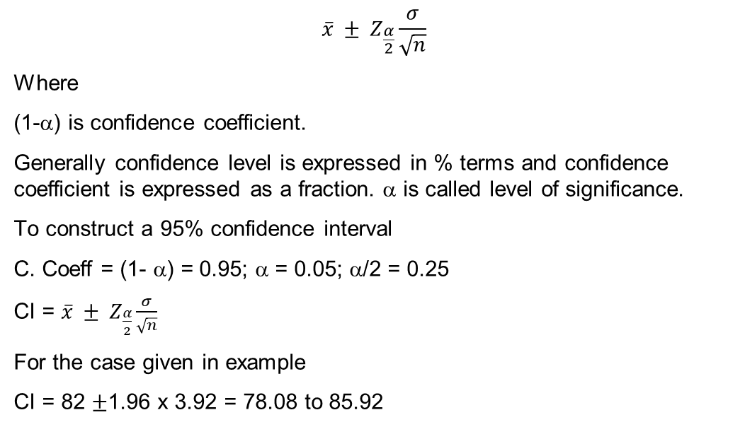
Interval Estimate for Population Mean (n ≥ 30)
$$\overline{x} ± Z_{\frac{α}{2}}\frac{σ}{\sqrt{n}}$$
Where
(1-α) is confidence coefficient.
Generally confidence level is expressed in % terms and confidence coefficient is expressed as a fraction. α is called level of significance.
To construct a 95% confidence interval
C. Coeff = (1- α) = 0.95; α = 0.05; α/2 = 0.25
CI = $\overline{x} ± Z_{\frac{α}{2}}\frac{σ}{\sqrt{n}}$
For the case given in example
CI = 82 ±1.96 x 3.92 = 78.08 to 85.92
When σ is Unknown Use s to Estimate σ

Slide 79
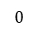
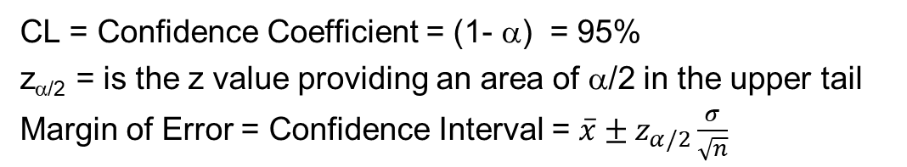
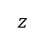
Interval Estimation of Population Mean
CL = Confidence Coefficient = (1- α) = 95%
z_{α/2} = is the z value providing an area of α/2 in the upper tail
Margin of Error = Confidence Interval = $\overline{x}±z_{α/2}\frac{σ}{\sqrt{n}}$
α/2
$$0$$
$$z$$
Confidence Level | α | α/2 | Z_{α/2}
90% | 0.10 | 0.05 | 1.645
95% | 0.05 | 0.025 | 1.960
99% | 0.01 | 0.005 | 2.576

Slide 80
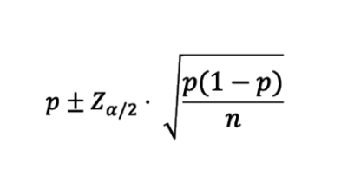
Interval estimation for Population Proportion
The theory behind a confidence interval of proportion is the same as that for a mean
Each element in the population can be considered as success or failure
Means and proportions are equivalent, except that proportion data is limited to binary values (1s and 0s)

Slide 81
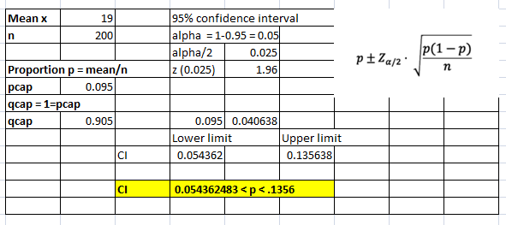
Estimating Population Proportion
A semi conductor manufacturer producers controllers used in automobile engine app. On random sample of 200 devices, found 19 are defective. Construct 95% confidence Interval around the true proportion defective
Solution :
(p) = 19/200 = 0.095
1-p = 1- 0.095 = .905

Slide 82
Interval Estimation for small Sample
Small Sample Cases: T- Distribution
When s is used to estimate σ, the margin of error and the interval estimate for the population mean are based on a probability distribution known as the t distribution.
When we have a sample of size < 30 and population standard deviation is unknown, in order to estimate population mean we use student “t” distribution with n-1 degrees of freedom.
Interval estimate of a population mean: σ Unknown

Slide 83
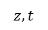
Small Sample Cases T- Distribution
When we have a sample of size < 30, population follows normal distribution and standard deviation is unknown, in order to estimate population mean we use student “t” distribution with n-1 degrees of freedom.
Standard normal distribution
Standard normal distribution (20 DF)
Standard normal distribution (10 DF)
$$z, t$$
$$0$$

Slide 84
T- Distribution Table
Degrees of Freedom | Area in Upper Tail
 | .2 | .1 | .05 | .025 | .01 | .05
1 | 1.3764 | 3.0777 | 6.3138 | 12.7062 | 31.8205 | 6.3138
2 | 1.0607 | 1.8856 | 2.9200 | 4.3027 | 6.9646 | 2.9200
3 | .9785 | 1.6377 | 2.3534 | 3.1824 | 4.5407 | 2.3534
4 | .9410 | 1.5332 | 2.1318 | 2.7764 | 3.7469 | 2.1318
5 | .9195 | 1.4759 | 2.0150 | 2.5706 | 3.3649 | 2.0150
6 | .9057 | 1.4398 | 1.9432 | 2.4469 | 3.1427 | 1.9432
7 | .8960 | 1.4149 | 1.8946 | 2.3646 | 2.9980 | 1.8946
8 | .8889 | 1.3968 | 1.8595 | 2.3060 | 2.8965 | 1.8595
9 | .8834 | 1.3830 | 1.8331 | 2.2622 | 2.8214 | 1.8331
10 | .8791 | 1.3722 | 1.8125 | 2.2281 | 2.7638 | 1.8125
11 | .8755 | 1.3634 | 1.7959 | 2.2010 | 2.7181 | 1.7959
12 | .8726 | 1.3562 | 1.7823 | 2.1788 | 2.6810 | 1.7823
13 | .8702 | 1.3502 | 1.7709 | 2.1604 | 2.6503 | 1.7709
14 | .8681 | 1.3450 | 1.7613 | 2.1448 | 2.6245 | 1.7613
15 | .8662 | 1.3406 | 1.7531 | 2.1314 | 2.6025 | 1.7531

Slide 85
T- Distribution Table
Degrees of Freedom | Area in Upper Tail
 | .2 | .1 | .05 | .025 | .01 | .05
16 | .8647 | 1.3368 | 1.7459 | 2.1199 | 2.5835 | 1.7459
17 | .8633 | 1.3334 | 1.7396 | 2.1098 | 2.5669 | 1.7396
18 | .8620 | 1.3304 | 1.7341 | 2.1009 | 2.5524 | 1.7341
19 | .8610 | 1.3277 | 1.7291 | 2.0930 | 2.5395 | 1.7291
20 | .8600 | 1.3253 | 1.7247 | 2.0860 | 2.5280 | 1.7247
21 | .8591 | 1.3232 | 1.7207 | 2.0796 | 2.5176 | 1.7207
22 | .8583 | 1.3212 | 1.7171 | 2.0739 | 2.5083 | 1.7171
23 | .8575 | 1.3195 | 1.7139 | 2.0687 | 2.4999 | 1.7139
24 | .8569 | 1.3178 | 1.7109 | 2.0639 | 2.4922 | 1.7109
25 | .8562 | 1.3163 | 1.7081 | 2.0595 | 2.4851 | 1.7081
26 | .8557 | 1.3150 | 1.7056 | 2.0555 | 2.4786 | 1.7056
27 | .8551 | 1.3137 | 1.7033 | 2.0518 | 2.4727 | 1.7033
28 | .8546 | 1.3125 | 1.7011 | 2.0484 | 2.4671 | 1.7011
29 | .8542 | 1.3114 | 1.6991 | 2.0452 | 2.4620 | 1.6991
30 | .8538 | 1.3104 | 1.6973 | 2.0423 | 2.4573 | 1.6973

Slide 86
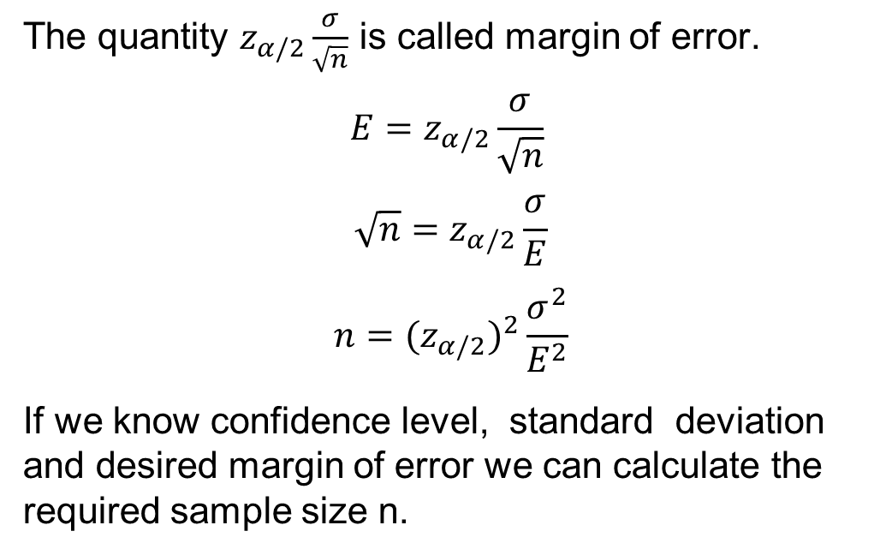
Sample Size Determination
The quantity $z_{α/2}\frac{σ}{\sqrt{n}}$ is called margin of error.
$$E=z_{α/2}\frac{σ}{\sqrt{n}}$$
$$\sqrt{n}=z_{α/2}\frac{σ}{E}$$
$$n={{(z}_{α/2})}^{2}\frac{σ^{2}}{E^{2}}$$
If we know confidence level, standard deviation and desired margin of error we can calculate the required sample size n.

Slide 87
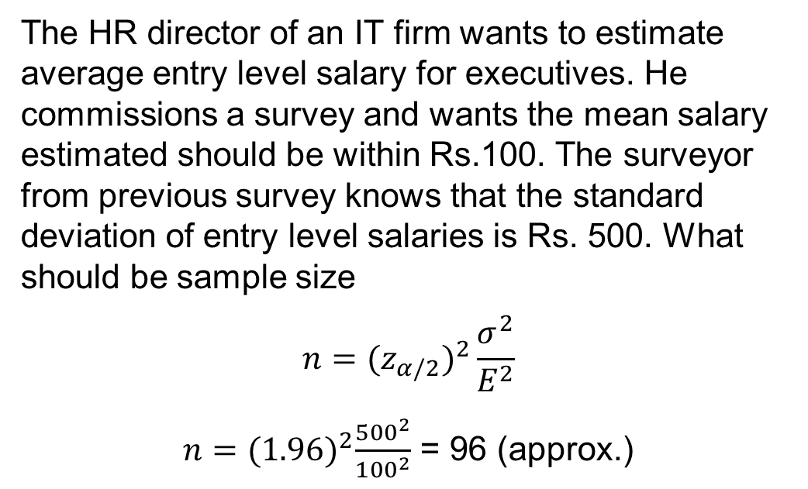
Sample Size Determination
The HR director of an IT firm wants to estimate average entry level salary for executives. He commissions a survey and wants the mean salary estimated should be within Rs.100. The surveyor from previous survey knows that the standard deviation of entry level salaries is Rs. 500. What should be sample size
$$n={{(z}_{α/2})}^{2}\frac{σ^{2}}{E^{2}}$$
$n={(1.96)}^{2}\frac{{500}^{2}}{{100}^{2}}$ = 96 (approx.)

Slide 88
Interval Estimation Procedure
Is n >= 30?
Yes
No
Is population normal?
Is σ known?
Yes
No
Yes
No
Is σ known?
Yes
No
Use the s to estimate σ
Use the s to estimate σ
Use
Use
Use
Use
Increase sample size to 30

